Slide 1

INFECTION PREVENTION & CONTROL

Slide 2
The goals for Infection Prevention program:
Protect the patient
Protect the healthcare workers, visitors and others in the healthcare environment
Prevent or reduce Healthcare-associated infections (HAIs)

Slide 3
Infection Prevention and Control Team
Dr. Debra Chew, MD – Medical Director of Infection Prevention and Antimicrobial Stewardship
Wina Padilla BSN, RN, CIC –Director of Infection Prevention
Nimfa Dagunton BSN, RN, CIC –Supervising Infection Preventionist
Monica Carter MS, RN, CIC – Infection Preventionist
Avalon Brown BSN, RN – Infection Preventionist
Derrick Sieck MPH – Infection Preventionist
Deborah Hughey – Infection Prevention Technician
Contact number for Infection Prevention and Control Department
Office: 973-972-5790 or 973-972-7081

Slide 4

Objectives:
Understand the overview of UH Infection Prevention & Control Program
Define some terms and discuss the impact of healthcare-associated infections (HAIs).
Describe the Chain of Infection and measures to break the chain.
Discuss Standard Precautions and Transmission-based Precautions
Familiarize with the proper use of surface and patient care equipment disinfectants
Describe Employee health related measures

Slide 5
What does the department of IP&C do ?
Our evidenced based program consists of efforts that result in a safer healthcare environment for our patients, staff and visitors:
Surveillance
Prevention and Assessment of HAI infections
• Staff education
• Performance Improvement projects
• Investigations of possible outbreaks or we conduct contact tracings for possible exposures

Slide 6
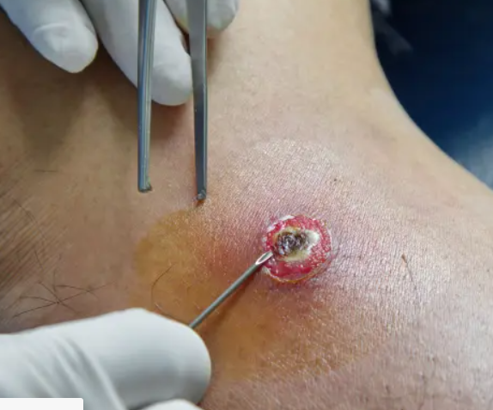
Definitions:
Infection:
Invasion and multiplication of an infectious agent in the tissue of a host.
Colonization:
Means that the organism can be found in or on the body but it is not causing any symptoms or disease.
Healthcare-associated Infection (HAIs):
An infection is considered HAI if the date of event occurs on or after the 3rd calendar day of admission to an inpatient location where day of admission is calendar day 1(not incubating nor present on admission).
Community Acquired Infection:
Infection that is present or incubating on admission to hospital that can be traced to a community source.

Slide 7
The impact of health care-associated infection (HAIs)
Can cause:
more serious illness.
prolongation of stay in a health-care facility.
long-term disability.
excess deaths.
high personal costs on patients and their families

Slide 8
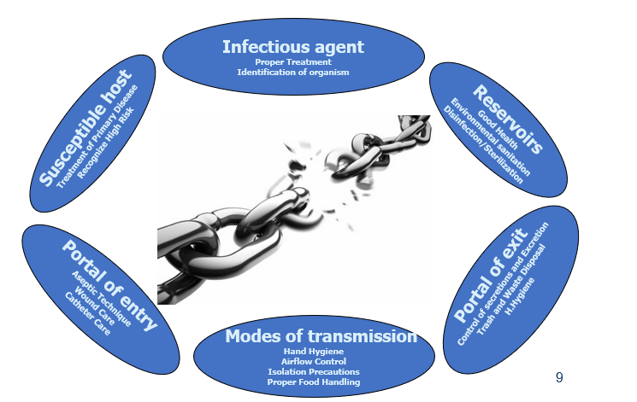
The Chain of Infection

Slide 9
Standard Precautions
Standard precautions are the foundation of infection prevention.
Used for every patient, every encounter regardless of infectious status.
Intended for the protection of the patients and the health care workers

Slide 10
Components of Standard Precautions
Hand Hygiene
Proper use of Personal Protective Equipment
Blood borne pathogens standard
Disinfection of environmental surfaces and patient-care equipment

Slide 11
Most frequent sites of infection and their risk factors
URINARY TRACT INFECTIONS
Urinary catheter
Urinary invasive procedures
Advanced age
Severe underlying disease
Pregnancy
Diabetes
LOWER RESPIRATORY TRACT INFECTIONS
Mechanical ventilation
Aspiration
Nasogastric tube
Central nervous system depressants
Antibiotics and anti-acids
Prolonged health-care facilities stay
Malnutrition
Advanced age
Surgery
Immunodeficiency
LACK OF HAND HYGIENE
Most common sites of health care- associated infection and the risk factors underlying the occurrence of infections
SURGICAL SITE INFECTIONS
Inadequate antibiotic prophylaxis
Incorrect surgical skin preparation
Inappropriate wound care
Surgical intervention duration
Type of wound
Poor surgical asepsis
Diabetes
Nutritional state
Immunodeficiency
Lack of training and supervision
BLOOD INFECTIONS
Vascular catheter
Neonatal age
Critical care Severe underlying disease
Neutropenia
Immunodeficiency
New invasive technologies
Lack of training and supervision
Notes:
Central nervous system depressants

Slide 12




The hip I had waited so long for got infected and had to be removed. I was devastated and so disappointed with it all. Now I have more pain than ever.
I CAN BE YOUR MOM
My catheter caused an infection, which meant
I spent another two weeks in hospital
I CAN BE YOUR HUSBAND
I CAN BE YOUR SON
I'm afraid to go into hospital for my cancer treatment in case I pick up an infection again.
My daughter went in to hospital for routine surgery but she developed an infection and died as a result. I’ll never trust hospitals anymore.
I CAN BE YOUR WIFE
Notes:
Patients' Experiences
What if someone you know needs healthcare treatment at some time? How will you feel about the risk of HCAI? Imagine if these patients were your loved ones:

Slide 13

Simple evidence…
Hand hygiene is the single most effective measure to reduce health care-associated infections

Slide 14
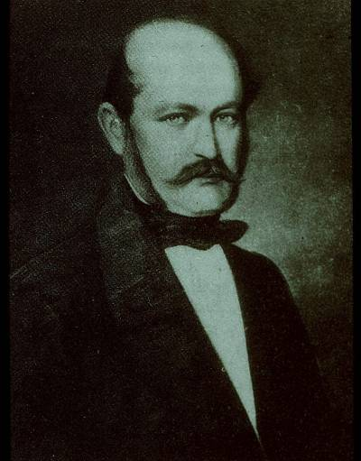
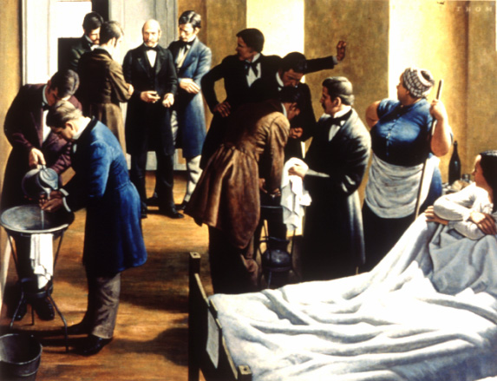
Ignaz Philipp Semmelweis: the pioneer of hand hygiene
Vienna, Austria
General Hospital,
1841-1850
Fighting puerperal fever

Slide 15
Maternal mortality rates, first and second obstetrics clinics, General Hospital of Vienna
18
16
Intervention
May 15, 1847
14
12
10
Percentage
8
6
4
First
2
Second
0
1841
1842
1843
1844
1845
1846
1847
1848
1849
1850
Semmelweis IP, 1861
Notes:
In 1847, Semmelweiss was appointed as a house officer in one of the two obstetric clinics located at the University of Vienna General Hospital. He observed that maternal mortality rates, mostly due to puerperal fever, were substantially higher in one clinic (first) compared to the other (second) (16% vs 7%). He also noted that physicians and medical students often went directly to the delivery suite after performing autopsies and had a disagreeable odor on their hands despite handwashing with soap and water before entering the clinic. He hypothesized therefore that “cadaverous particles” were transmitted via the hands of students and physicians and caused the puerperal fever. As a consequence, Semmelweis recommended that hands be scrubbed in a chlorinated lime solution before every patient contact and particularly after leaving the autopsy room. Following the implementation of this measure, the mortality rate dropped dramatically to 3% in the clinic most affected (first).

Slide 16
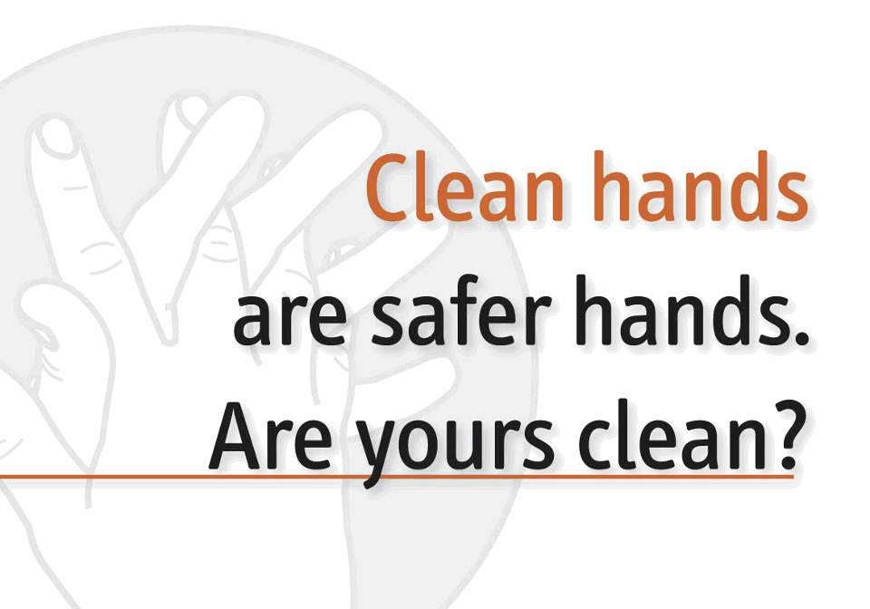

Slide 17
Why should you clean your hands?
Any health-care worker, caregiver or person involved in patient care needs to be concerned about hand hygiene
Therefore hand hygiene does concern you!
You must perform hand hygiene to:
protect the patient against harmful germs carried on your hands or present on his/her own skin
protect yourself and the health-care environment from harmful germs

Slide 18
Application time of hand hygiene and reduction of bacterial contamination:
0
Hand rubbing is:
more effective
faster
better tolerated
Handwashing
Handrubbing
1
2
Bacterial contamination (mean log 10 reduction)
3
4
5
6
0
15sec
30sec
1 min
2 min
3 min
4 min

Slide 19
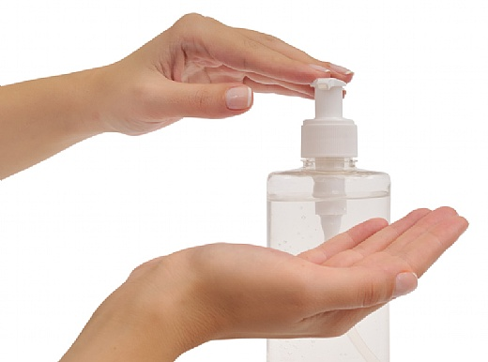
Hand rubbing is the solution to obstacles to improve hand hygiene compliance
Handwashing with soap and water only when hands are visibly dirty or following visible exposure to body fluids (and dealing with spores forming germs)
Adoption of alcohol-based handrub is the gold standard in all other clinical situations

Slide 20

Time constraint = major obstacle for Hand Hygiene
Handwashing: 40-60 seconds
Average time usually adopted by health-care workers: <10 seconds
Alcohol-based hand rubbing: 20–30 seconds
'Based on the 'How to Handwash', URL: http://www.who.int/gpsc/5may/How_To_HandWash_Poster.pdf © World Health Organization 2009. All rights reserved.'

Slide 21
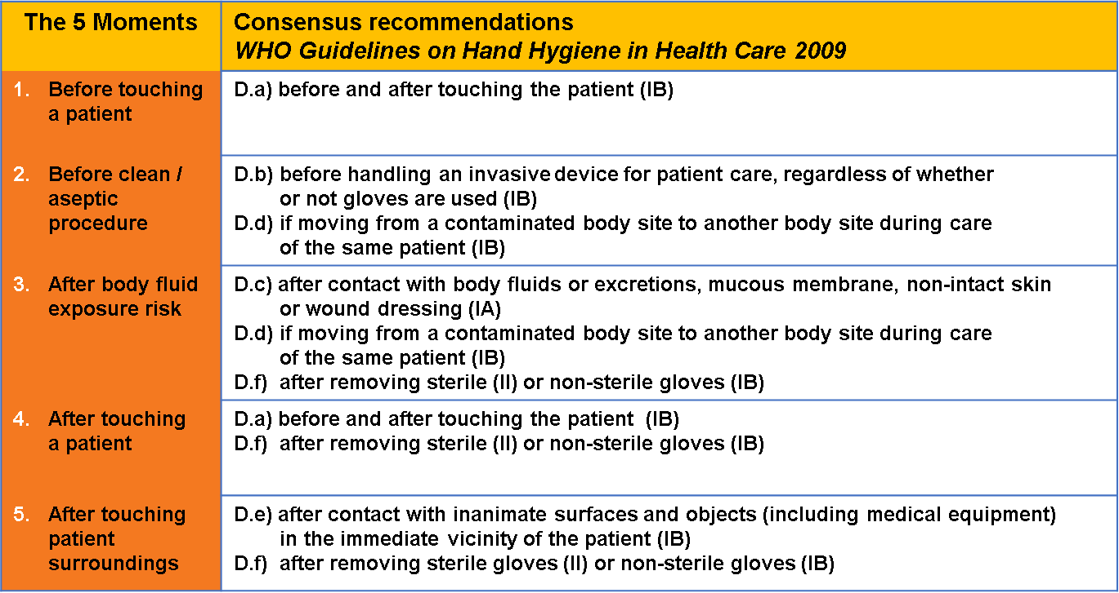
The 5 Moments of Hand hygiene

Slide 22
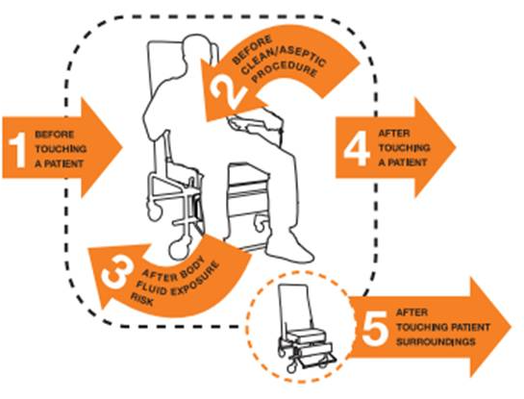
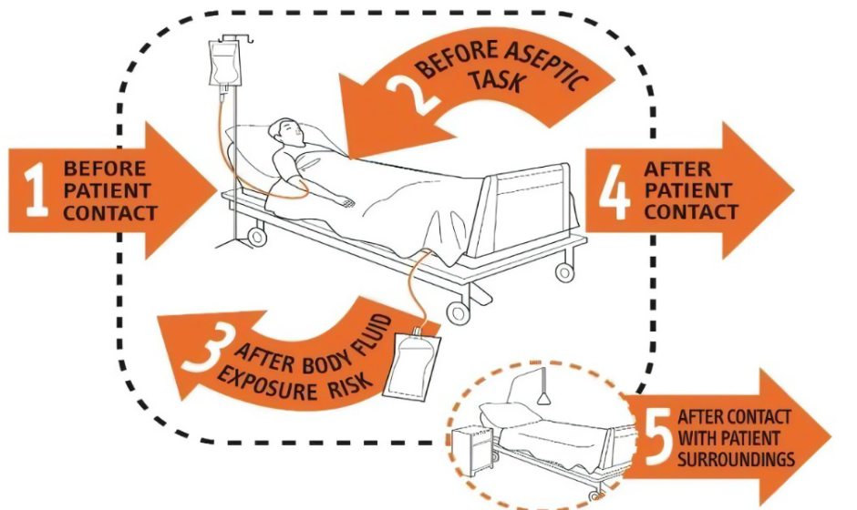
The moments apply to any setting where health care involving direct contact with patients takes place

Slide 23
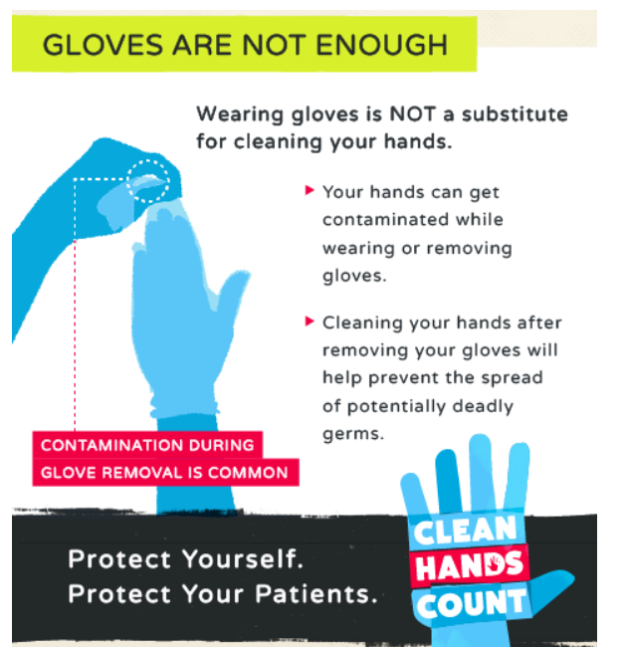
The use of gloves does not replace the need for cleaning your hands!

Slide 24
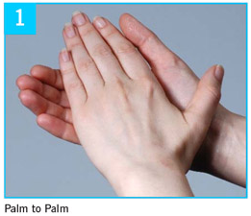
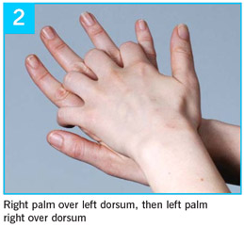
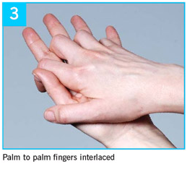
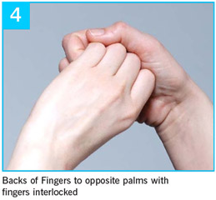
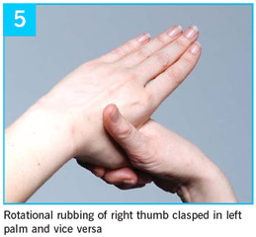
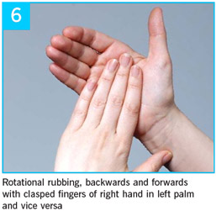
How do I perform Hand Hygiene?

Slide 25
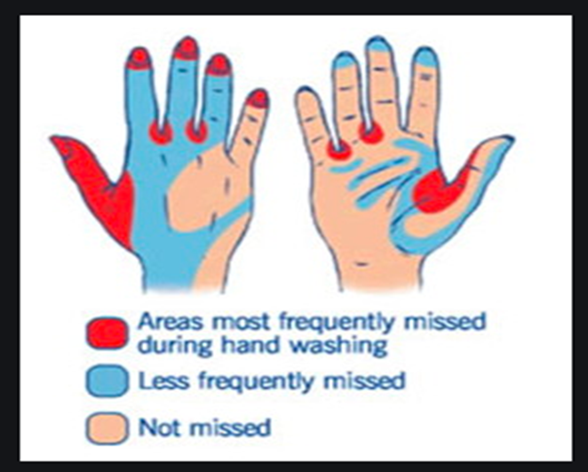
Areas most frequently missed

Slide 26

Fingernail Guidelines
Natural fingernails
Tips no longer than ¼ inches
Smooth without rough edges
Nail polish
Cannot be chipped or peeling, must be in good repair
Artificial fingernails
No artificial nails or decorations such as tips, nail gel, acrylic nails, nail jewelry are permitted.

Slide 27
The use of Personal Protective equipment (PPE):
Gloves - when there will be contact with blood, body fluids, mucus membranes, non-intact skin or other potentially infectious materials.
Gown: when there will be contact with blood, body fluids, or other potentially infectious substances to protect the skin and prevent soiling or contaminating your clothing.
Mouth, nose and Eye protection: when there will be splashes or sprays of blood, body fluid, secretions or excretions.

Slide 28
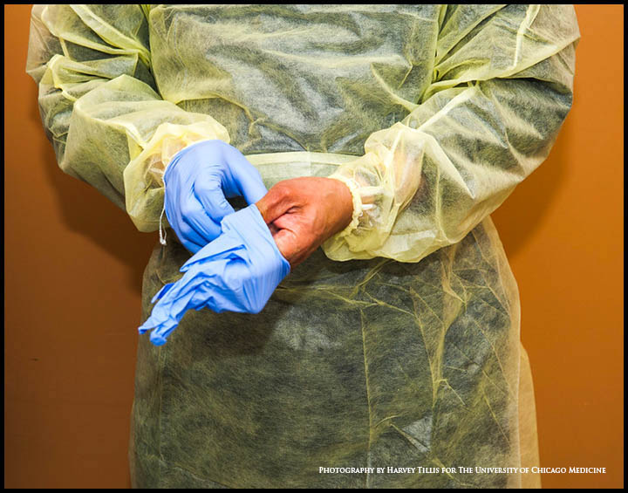
Personal Protective Equipment (PPE)
Use PPE carefully – DON’T cross contaminate!
Do not wear PPE outside treatment area or in hallways
Don before contact with patient
Remove and discard carefully prior to leaving patient care area or treatment area.
Remove respirator outside room.
Perform hand hygiene before donning and after doffing of PPE.

Slide 29
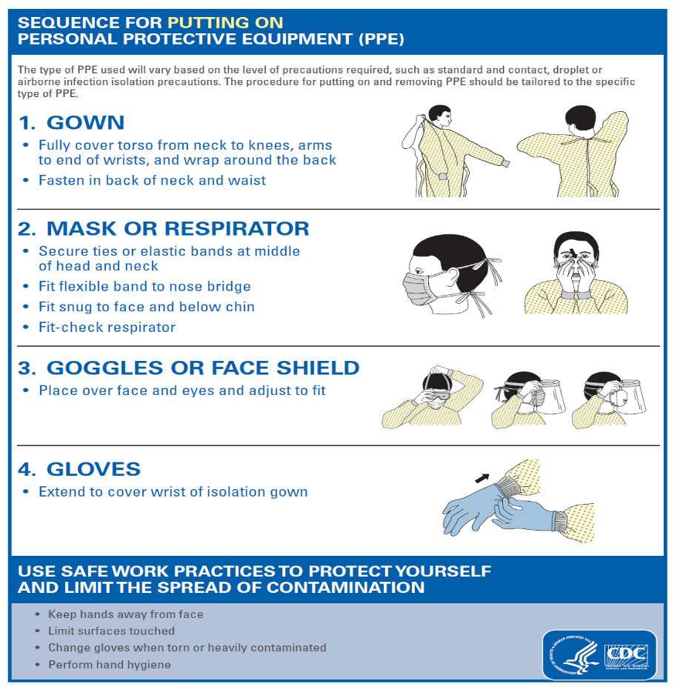
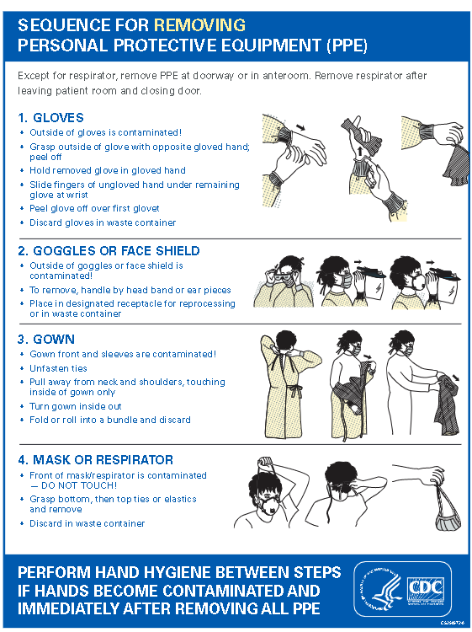
Sequence of Donning and Doffing of PPE:

Slide 30

BBP – Bloodborne Pathogens
BBP such as HIV, HBV, HCV are spread by contact with blood & body fluids.
Healthcare workers can be exposed….
Percutaneously by
accidental sharps injury with
needles, scalpels etc.
By mucous membranes by
splashes to the eyes, nose and mouth
Via non-intact skin such as
chapped hands, lesions , psoriasis etc.

Slide 31
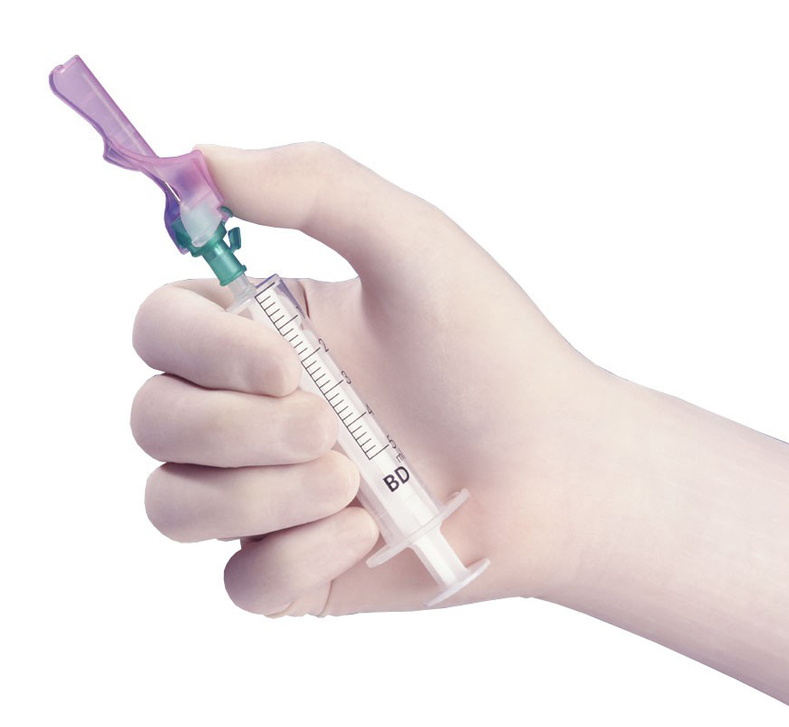
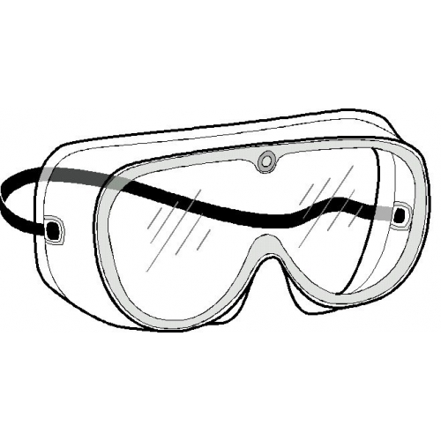
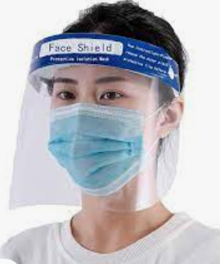
Preventing a BBP exposure
Know how to engage safety devices properly
Once you have used the device, immediately discard in sharps container
Call 1500 immediately if you notice sharps container is full
Preempt task you are performing and wear proper PPE, for example eye or face shield when splashes might occur

Slide 32

After a BBP Exposure
Wash the area with soap and water immediately.
If a mucous membrane was exposed, flush with water.
For UH employees report to the Employee Health Office(G level) Ext.2-3066 Monday – Friday 7:30am – 3:30pm. For Rutgers employees, report to Occupational Medicine at 65 Bergen Street (Stanley Bergen Building). Ext.2- 2900. If you are seen at the ED, make sure to complete Incident Report and bring to EH and/or Occupational Medicine during the next business hours.

Slide 33

Bloodborne Pathogens Exposure Control Plan
Purpose:
To provide a safe working environment and reduce the risk of exposure to blood-borne pathogens.
The Exposure Control Plan can be accessed by clicking on the following link. Login is required:
https://universityhospital.ellucid.com/documents/view/2408/5931
In the event of a blood or other infectious spill
Call 2-1500

Slide 34
Engineering Controls:
Sharps Containers
Safety needles (self-sheathing)
Needle-less IV system

Slide 35
Disinfection
The effective use of disinfectants on patient-care items or surfaces is part of a multi-barrier strategy to prevent transmission of healthcare associated infections.
Visible soiling must be removed first.
All patient care items used for multiple patient contacts must be adequately disinfected between uses.
A hospital-approved detergent disinfectant must be applied and allowed to air dry before the next patient contact.
Follow label direction for surface contact/air dry time.

Slide 36
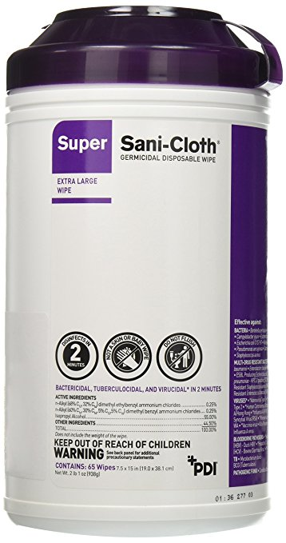
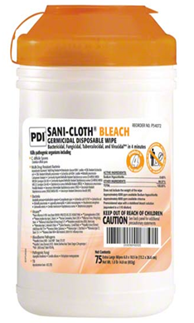
Disinfectant wipes:
Contact time or wet time is how long a disinfectant needs to stay wet on a surface in order to be effective.

Slide 37
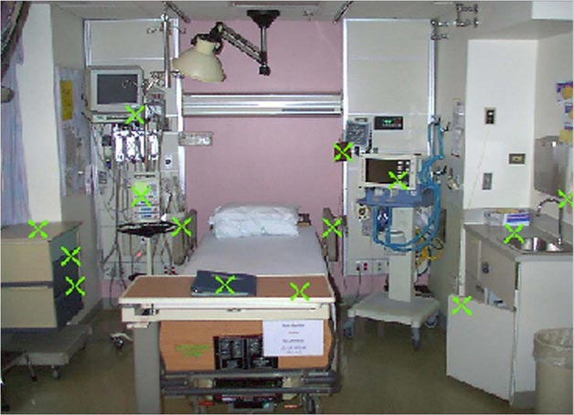
Environmental Contamination with Multi-drug resistant organisms:

Slide 38
How long are surfaces contaminated?
Organism | Duration of persistence
Acinetobacter | 3 days – 5 months
C. difficile | 5 months
Enterococcus (including VRE) | 4 months
Klebsiella | >30 months
Pseudomonas | 16 months; on dry floor – 5 weeks
S. aureus (including MRSA) | 7 months
Hepatitis A virus | 60 days
Hepatitis B virus | >1 week
HIV | >7 days
Influenza virus | 1-2 days
RSV | Up to 6 hours
Norvirus (Cruise Ship virus) | 7 days

Slide 39
Transmission-based Precautions
Used when Standard Precautions alone are insufficient to prevent the spread of pathogens, used also when the infectious status of patient is known or suspected with epidemiologically significant organism (e.g., highly transmissible)
Determined by the modes of transmission of the infecting agent
Different Categories of precautions (Isolation)
Contact
Special Contact
Enhanced Contact
Droplet
Airborne
Contact /Droplet
Contact/Airborne
Protective

Slide 40
Contact Precautions 3 levels:
I. General Contact Precautions
- an Isolation is designed to interrupt transmission of infection spread by contact route.
Must be used in conjunction with Standard Precautions.
Requires a single room/private with signage.
Used for patients known or suspected to be infected or colonized with antibiotic-resistant organisms such as MRSA, VRE, ESBL gram negative bacteria
Communicable skin conditions such as lice and scabies
Varicella-zoster (localized) among immunocompetent patients

Slide 41
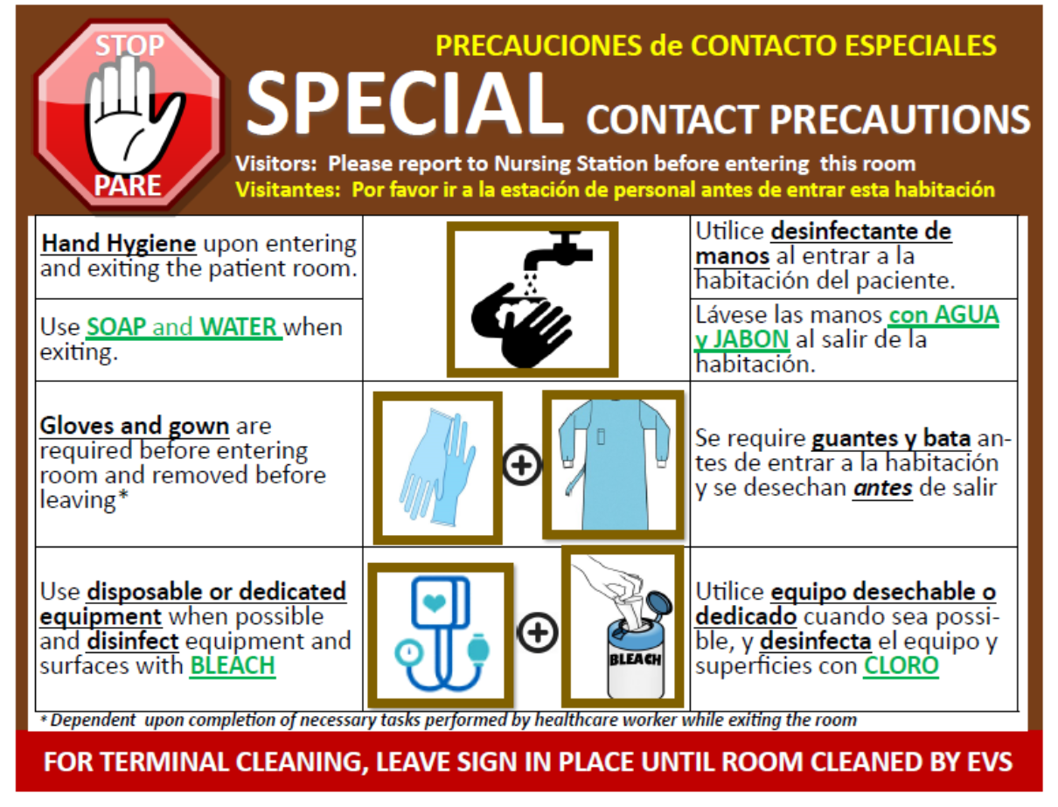
II. Special Contact Precautions
- Are used for diseases such as :
Clostridium Difficile
Norovirus
Special Contact Precautions require (in addition to guidelines for General Contact Isolation Precautions):
Hand hygiene with soap and water after contact with the patient and his/her environment
Use of a bleach-based product for cleaning reusable equipment used on the patient and cleaning of his/her environment

Slide 42
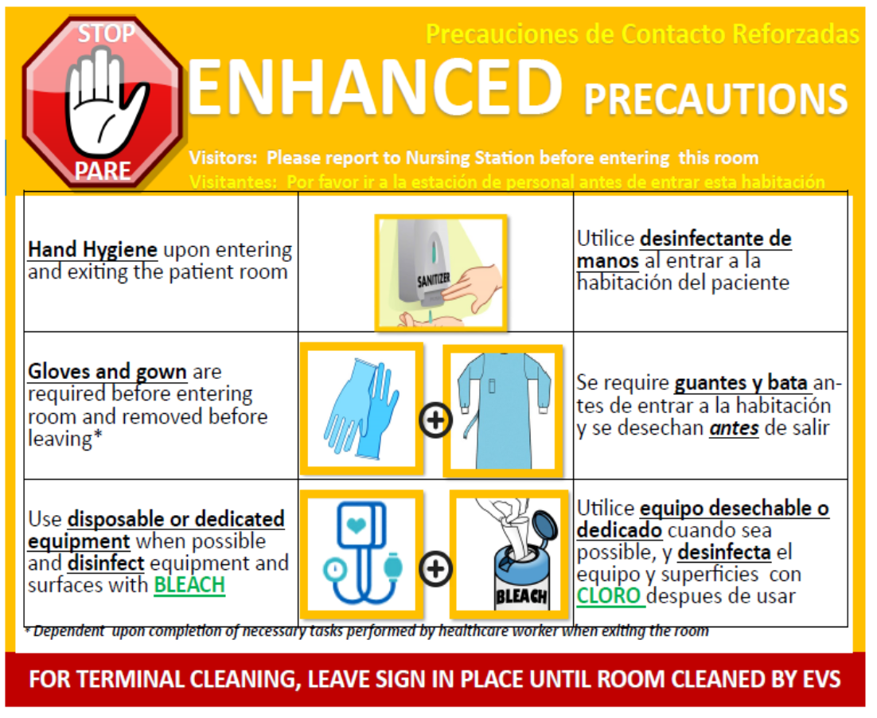
III. Enhanced Contact Precautions
Are used for those diseases such as:
Candida auris
Carbapenem Resistant Acinetobacter
Extremely drug resistant (XDR) Gram Negative bacteria
Enhanced Contact Precautions require (in addition to guidelines for General Contact Isolation Precautions):
Hand hygiene with alcohol-based hand sanitizer before and after contact with the patient and his/her environment
Use of a bleach-based product for cleaning reusable equipment used on the patient and cleaning of his/her environment
Patients on Enhanced Contact Precautions will be maintained on isolation indefinitely

Slide 43
Guidelines for Isolation & Criteria for discontinuing isolation for Multidrug-resistant Pathogens
Pathogen | Type of Isolation | Duration of contact isolation | Criteria for discontinuing isolation
Clostridium difficile | Special Contact | Minimum 10 days | Completed minimum 10 days of treatment and resolution of diarrhea for at least 48 hours; Ensure terminal after discharge or transfer; use enhanced cleaning if patient remains in room
MRSA | Contact | 1 year unless cleared earlier | Off antibiotics for at least 72 hours before surveillance cultures performed & 1 negative swab from anterior nares
VRE | Contact | 1 year unless cleared earlier | Off antibiotics for at least 72 hours before surveillance cultures performed & 2 negative swab from rectum obtained 7 days apart.
ESBL E coli, Gram negatives | Contact | 1 year | Resolution of active infection & at least 12 months since last positive culture
CRE E coli, Kleb oxytoca pr pneumoniae or enterobacter | Enhanced Contact | Indefinitely | Consult Infection Prevention and Control
MDR- Acinetobacter or Carbapenem-resistant | Enhanced Contact | Indefinitely | Consult Infection Prevention and Control
MDR Gram negatives | Enhanced Contact | Indefinitely | Consult Infection Prevention and Control
Extemely Drug resistant (XDR) gram negatives | Enhanced Contact | Indefinitely | Consult Infection Prevention and Control
VISA or VRSA | Enhanced Contact | Indefinitely | Consult Infection Prevention and Control
Candida auris and associated organism | Enhanced Contact | Indefinitely | Consult Infection Prevention and Control

Slide 44
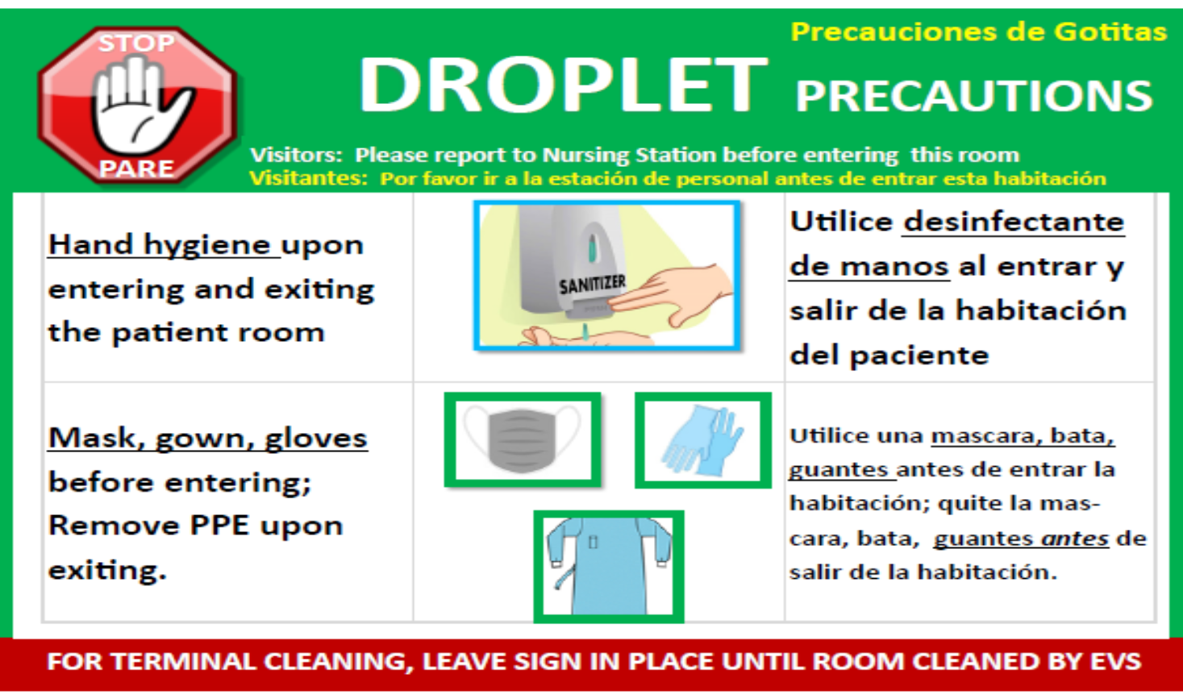
Droplet Precautions
Use for patients known or suspected to be infected with pathogens transmitted by respiratory droplets that are generated by a patient who is coughing, sneezing, or talking.
Must be used in conjunction with Standard Precautions.
Requires close contact (<3ft) for transmission.
Pertussis
Meningococcal meningitis
Rubella
Influenza

Slide 45
Airborne Precautions:
Use Airborne Precautions for patients known or suspected to be infected with pathogens transmitted by the airborne route generated when a patient coughs, sneezes or talks or through aerosolizing procedures ( e.g. intubation).
Used for patients known or suspected to be infected by:
Pulmonary TB
Chickenpox
Disseminated herpes zoster in immunocompetent patients
Localized herpes zoster in immunosuppressed patients
Measles
Requires a single room with negative pressure ventilation keep the door closed.
A portable HEPA filter machine may be used temporarily while the patient is awaiting placement in a negative pressure room
HCWs wear an N95 mask (fit tested and seal check), patients wear a surgical mask when transported out of his/her room.

Slide 46
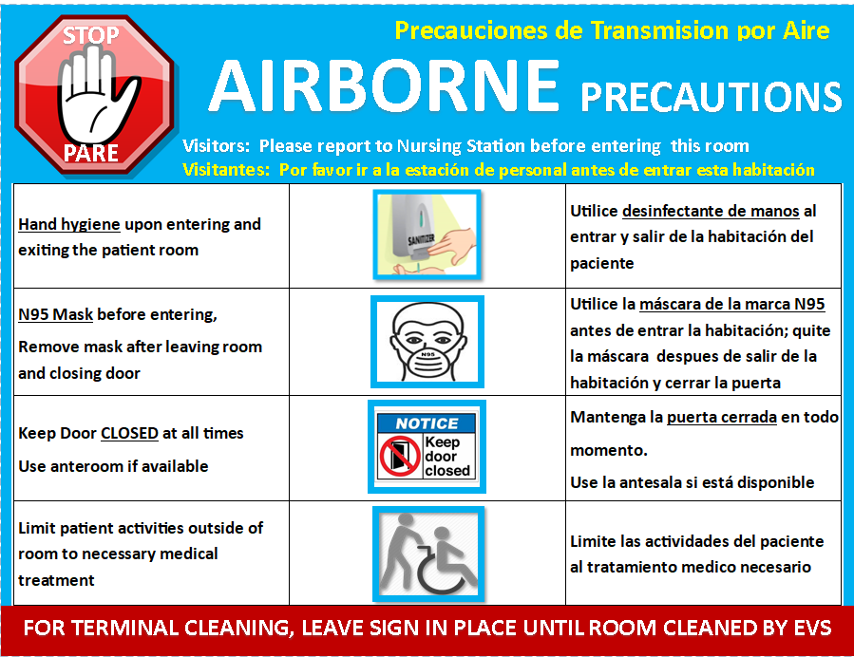
Airborne Precaution Signage

Slide 47
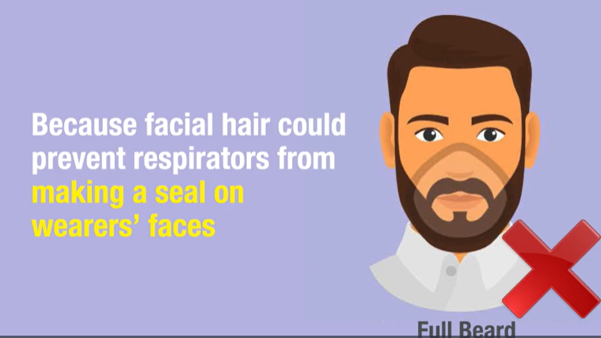
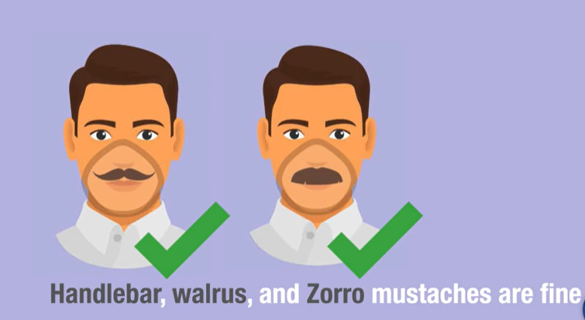
Federal and State Public Employee Occupational Safety & Health (PEOSH) guidelines on facial hair and N95 respirators
Federal OSHA and State PEOSH laws ban the use of N95 respirators by employees with facial hair (such as full beard and long sideburns) the hair prevents the respirator from creating a tight seal around the face .
Hair inside the respirator (such as small mustache) does not prevent a good seal.
Employees must ensure that they are clean shaven (no beard/hair) wherever the seal (edges of the respirator) touches the face.
**Further Optional Reading: The effect of facial hair on respiratory facepiece fit.

Slide 48
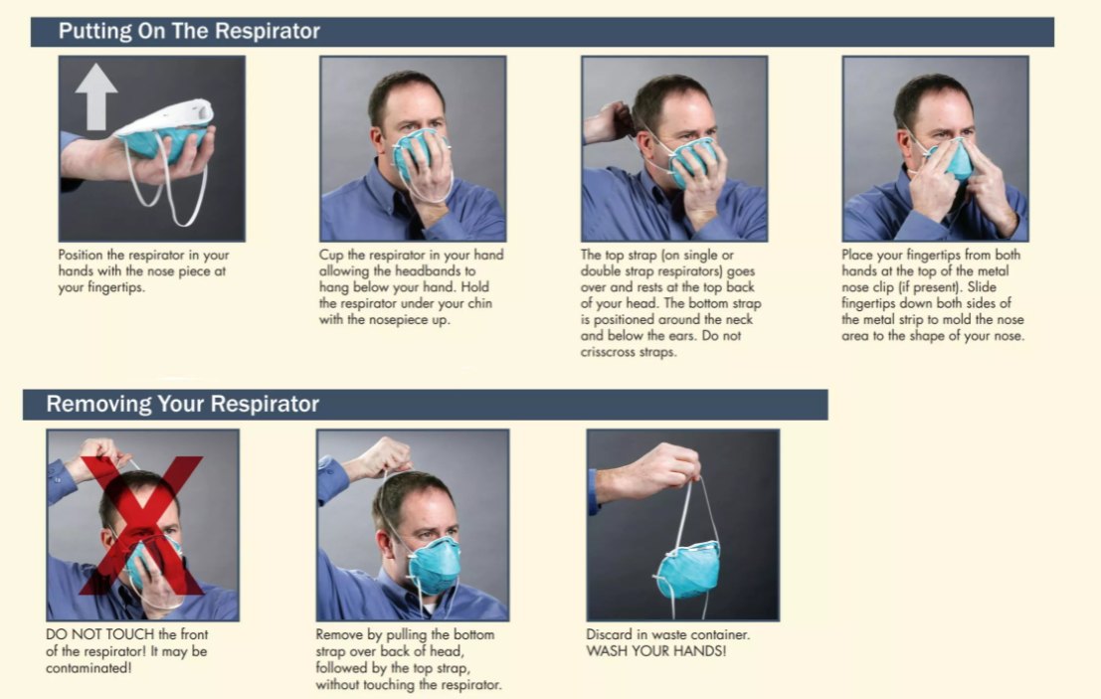
How to don and doff an N95 mask:

Slide 49
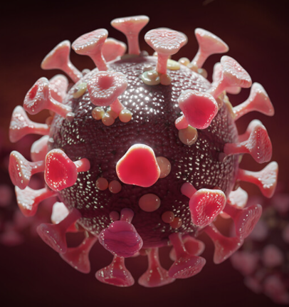
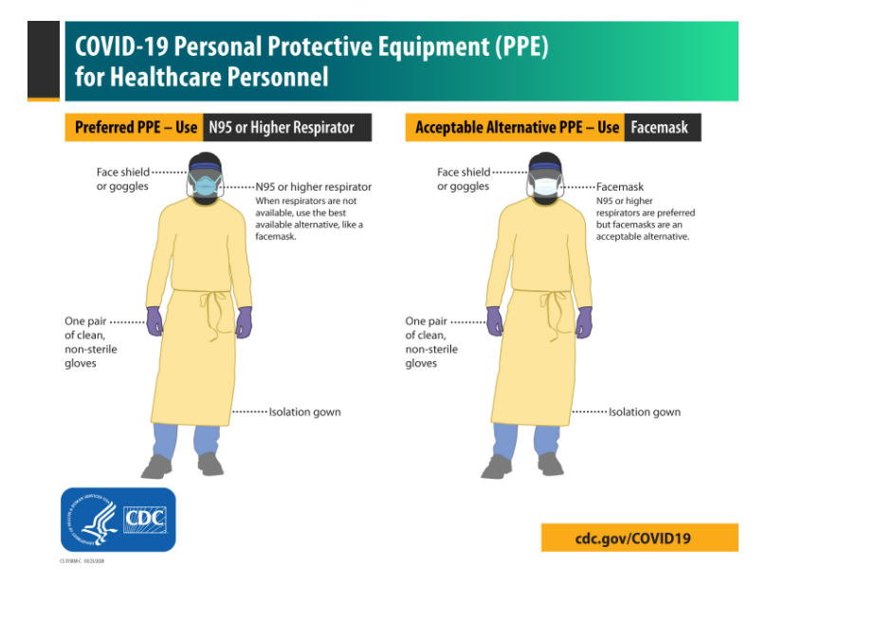
COVID-19 Isolation Precautions
In ICUs, PCUs and for patients with aerosolized generating procedures requires Airborne and Contact Precautions plus eye protection.
In Non-ICUs such as Clinics, ER, Med surg/Observation units requires Droplet and Contact Precautions plus Eye protection.

Slide 50
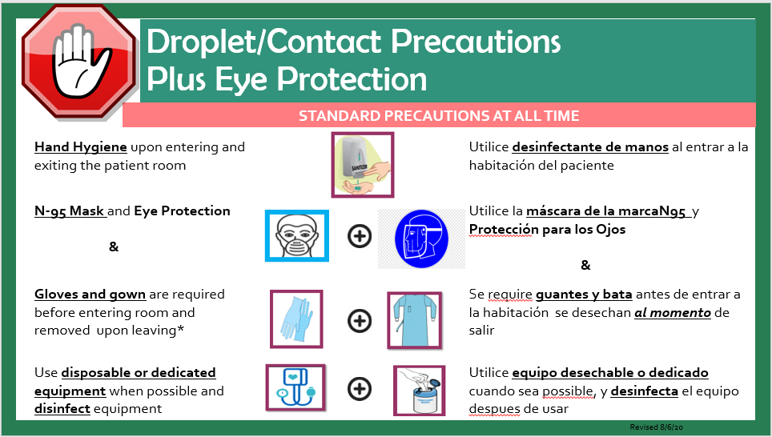
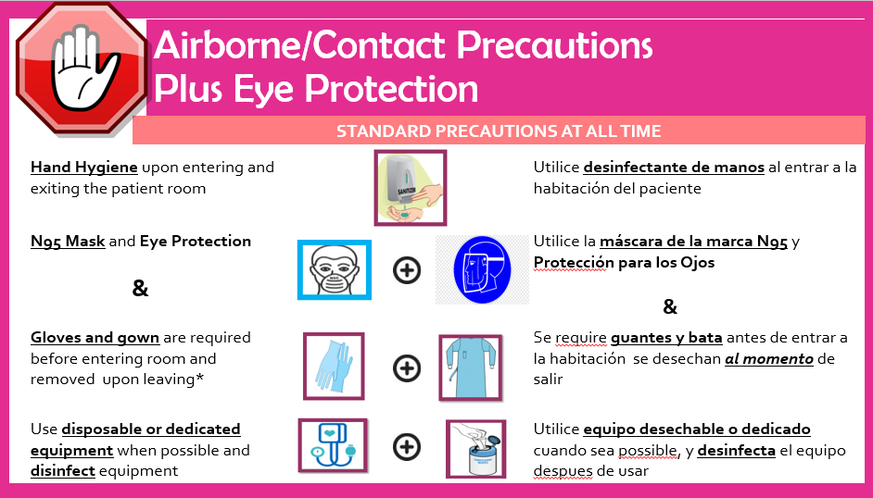
COVID-19 isolation signage:

Slide 51
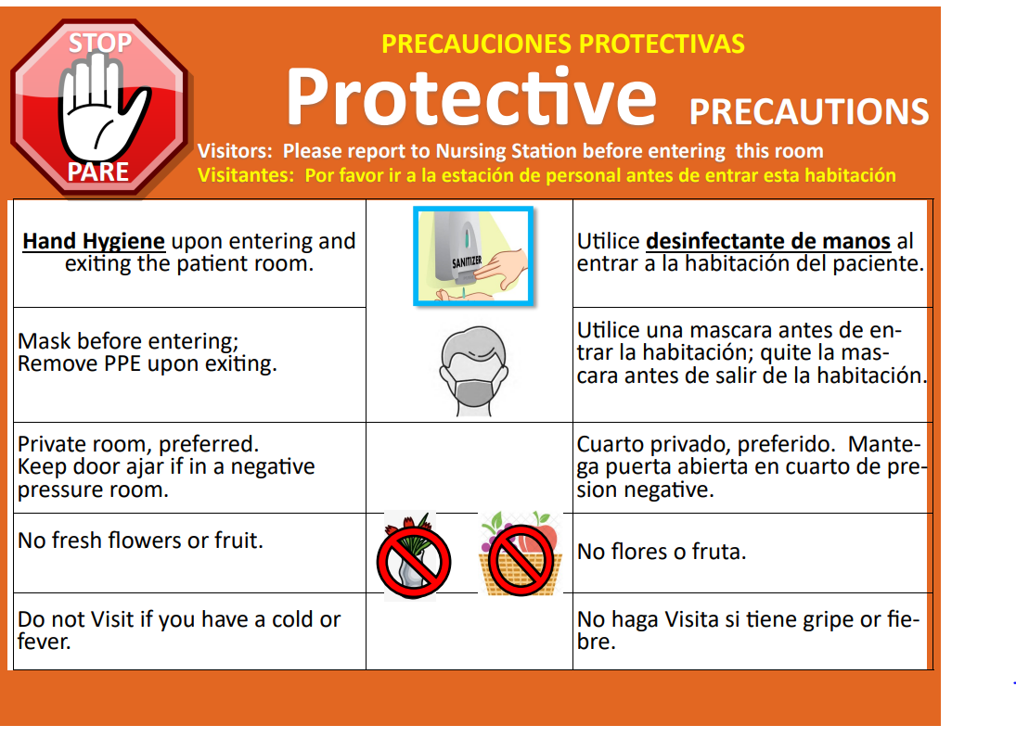
Protective Precautions
Hand hygiene
Mask
Private room preferred
No fresh flowers or fruits
Do Not visit if you have a cold or fever.

Slide 52


Set the GOAL to ZERO Infections.
We have a comprehensive “Bundles of care protocol” which we follow when managing patients with devices such as Central venous catheters, Foley catheters, ventilators and for those patients who will undergo surgeries. A more detailed discussion would be provided for our clinical staff.

Slide 53
TB Testing
University Hospital (UH) employees are tested by Employee Health (EH)
Interferon-Gamma Release Assays (IGRAs) – Blood Tests for TB Infection
What are they? are whole-blood tests that can aid in diagnosing Mycobacterium tuberculosis infection.
QuantiFERON®-TB
Frequency of TB Testing: UH employees based on risk assessment per new CDC guidelines
Employees with positive TB tests are not tested again after their positive tests are known and documented by Employee Health.
Employees with a history of a positive TB test will complete an annual symptom survey.
For any exposure evaluation is done through Employee Health
- Tested for TB if previously negative.
- If TB test becomes positive, additional follow up is done.

Slide 54
TB Exposure: Identifying the symptoms
Early Recognition
Recognize signs and symptoms
Adequate specimen testing
Initiate and maintain appropriate isolation

Slide 55
Infection vs. Active Tuberculosis
Infection (Latent TB)
Positive skin test or blood test
Normal chest x-ray
No symptoms
Negative sputum test
Medications to prevent
active disease
No isolation
Not Infectious
Active TB infection
Positive skin test or blood test
Abnormal chest x-ray
Symptomatic ( cough, fever, with weight loss)
Positive sputum smear or culture
Medications to treat disease
Isolation required
Infectious

Slide 56
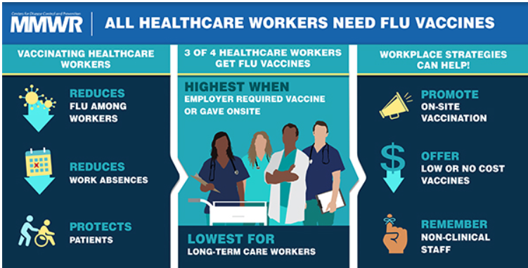
Influenza Vaccination
University Hospital requires annual Influenza vaccination among our staff unless there is a medical or religious waiver.

Slide 57
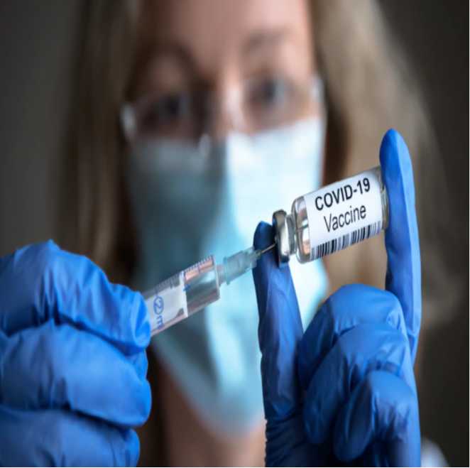
COVID-19 VACCINATION among HCWs:
GET VACCINATED!
The NJ Mandate on COVID-19 Vaccination:
All New Jersey hospital workers are required to be full vaccinated, including booster shots, in order to comply with a federal mandate.
Exemptions for accepted medical or religious reasons remain in place.
At UH we have a Universal Masking Policy, which requires you to wear surgical mask at all times in the hospital.
You are required to wear an N95 mask and face shield when you are taking care of a patient of unknown COVID-19 status and all positive COVID-19 patients.

Slide 58


